Slide 1
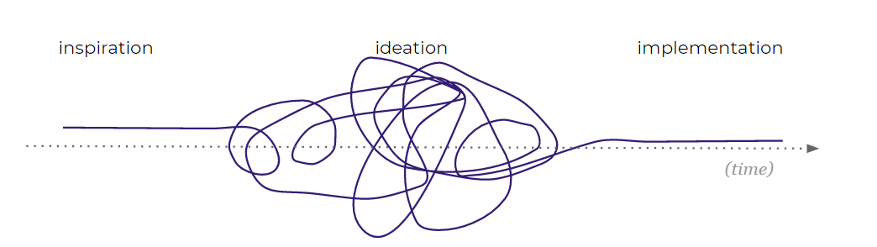
OUR INTERVIEWS

Slide 2

Design Thinking:
the process
ALIGNMENT
LEARNING
ANALYSIS
IDEATION & ENVISIONING
EVALUATE & REFINE
Focus
Identify problems worth solving
Envision holistic solution
Identify who to interview and how many interviews
Schedule, script, and conduct interviews
Identify themes and insights through affinity mapping
Ideate opportunities and build to solve the problems identified
Test resonance and recommend future roadmap
Notes:
I actually just finished a project in partnership with Yang Wei Neo on BIAV and three URAD Go For Coders where we actually used this process to better understand the interaction points between our Hi Chelsea,
Thanks! Sounds good. Does the Monday after next work for everyone? It looks like it catches us right between travel and FTO ☺
Best,
Maggie

Slide 3
ALIGNMENT
LEARNING
ANALYSIS
IDEATION & ENVISIONING
EVALUATE & REFINE
Alignment
Stakeholder conversations
Notes:
I actually just finished a project in partnership with Yang Wei Neo on BIAV and three URAD Go For Coders where we actually used this process to better understand the interaction points between our Hi Chelsea,
Thanks! Sounds good. Does the Monday after next work for everyone? It looks like it catches us right between travel and FTO ☺
Best,
Maggie

Slide 4
Project Goals
What has led us to start this project?
We want to eliminate inefficiencies in the quoting process and avoid duplicate work
What do we want to learn?
How does our quoting team approach their work? What do they enjoy, what is frustrating? Is there anything that works well for them now?
What are we building?
A simpler, combined quoting system
What does success look like?
A quicker quote that is easy for staff and agents to use and buy in to
Notes:
Design thinking encourages organizations to focus on the people they're creating for.
It’s about simple mindset shifts or ways of asking questions differently – a new way to look at problems.

Slide 5
ALIGNMENT
LEARNING
ANALYSIS
IDEATION & ENVISIONING
EVALUATE & REFINE
Learning
Customer research
Notes:
I actually just finished a project in partnership with Yang Wei Neo on BIAV and three URAD Go For Coders where we actually used this process to better understand the interaction points between our Hi Chelsea,
Thanks! Sounds good. Does the Monday after next work for everyone? It looks like it catches us right between travel and FTO ☺
Best,
Maggie

Slide 6
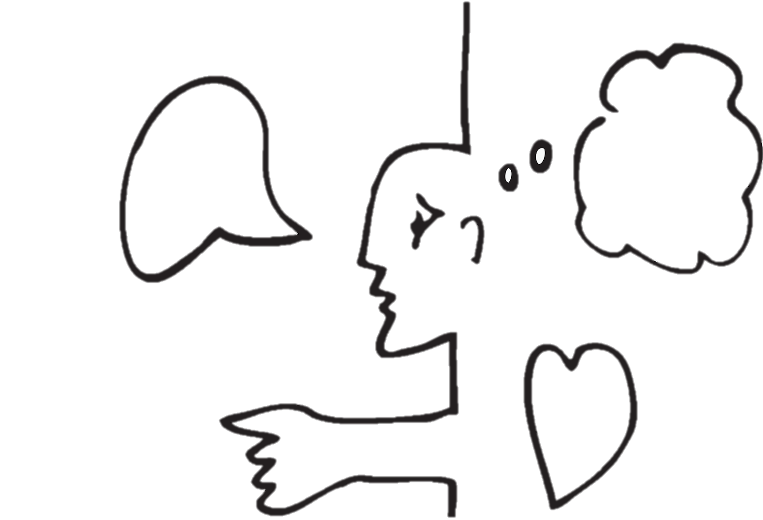
Through observation and empathy, focusing on what people…
say
think
feel
do
use
Notes:
The core of design thinking is getting actionable and knowing your questions. It’s about simple mindset shifts or ways of asking questions differently—a new way to look at problems.

Slide 7
Empathy Research
Immersion
Immersing yourself in their work and environment
Analogous Inspiration
Try doing something similar to put yourself in their shoes
Observing
Watch someone experience a process in their own setting
Interview
Talk to them directly to understand hopes, desires, and aspirations
Notes:
Design thinking encourages organizations to focus on the people they're creating for.
It’s about simple mindset shifts or ways of asking questions differently – a new way to look at problems.

Slide 8
Interview Tips
Stay open-minded -- Ask open-ended questions
Treat it as a conversation. Keep asking “why” until you get to the underlying meaning
Ask naïve questions
Unassuming questions encourage them to explain their logic
Embrace the pause
Give time to reflect and answer- don’t assume you know what they’ll say
Minimize your presence
Smile and nod, avoid making them feel like you’re testing them
Tell me about a time when…
Ask to tell a story about an event in their past
Mind the gap
Sometimes they contradict themselves. Dig deeper if things don’t match up. Might lead to an insight
Notes:
Design thinking encourages organizations to focus on the people they're creating for.
It’s about simple mindset shifts or ways of asking questions differently – a new way to look at problems.

Slide 9
How to dig deeper
“I noticed you…”
Use an observation to objectively get them to talk more
“Can you show me?”
Ask them to show how they ‘always’ do things so you can see if they do it differently than they self-report
“Why?”
You might ask why 3 or 4 times to reach an underlying issue
“I always send an email to do that.” “An email…?”
Repeat the action word of their sentence in a questioning way
“Why do you do that?”
They are the expert at their work. Don’t correct them, instead try to understand their perspective
Remember, different techniques work for different personalities. If one doesn’t work, try another
Notes:
Design thinking encourages organizations to focus on the people they're creating for.
It’s about simple mindset shifts or ways of asking questions differently – a new way to look at problems.

Slide 10
The 5 whys
Functional needs
Conscious
Why?
I am worried Liberty doesn’t fully understand the unique risks of my customer
Tell me more?
AQA has reclassified my customers before and might do so again if I got class wrong
RIGHT IDEA
Why is this important?
It usually changes the price or cancels the policy, and then I have to shop it again
Why does this concern you?
It takes my time and I have to then explain this to my customer, which is not fun
Why does it make you feel this way?
It can hurt my reputation as an expert and make me look inept in my community
Unconscious
Emotional needs

Slide 11
What does our script look like?
Getting to know you: Get them to open up and give us a good background about their work.
How did you get started in insurance?
What aspects of your work do you really enjoy? Why?
What gets in the way of doing the work you enjoy most?
Wide Net: Start off with some high-level questions about goals and work.
What are your main goals in your role?
Daily?
Monthly?
Annually?
Why?
Who do these goals benefit?
What makes that important to you?
What top-of-mind tools do you needed to succeed at these goals?
Is there anything we don't provide today, that you need to do your job and fulfill your goals?
Anything we provide that's not good enough?
Why?
Deep Dive: I would now like to dive deep into questions about your workflows, and fill in any gaps we are missing.
What are your main pain points throughout the quoting process?
Before starting a quote / during a quote / during processing / bringing a quoted price back to the customer / during the binding and payment process / after the account is bound
What is the most important goal or problem you want solved by speaking to an agent? What do they want solved?
Can you tell us about a time when you had a very positive experience with an agent and why?
Is there anything you need to do your job well and meet your goals that we did not capture here?
Don't forget to dig deeper!
“Why” “can you speak to that a bit more?”, “can you explain what you mean by that?” If they don't have more to say see if you can probe around it
"What do you think you would do if we took that away?/if we built it?"
Notes:
Design thinking encourages organizations to focus on the people they're creating for.
It’s about simple mindset shifts or ways of asking questions differently – a new way to look at problems.

Slide 12
ALIGNMENT
LEARNING
ANALYSIS
IDEATION & ENVISIONING
EVALUATE & REFINE
Analysis
themes and insights
Notes:
I actually just finished a project in partnership with Yang Wei Neo on BIAV and three URAD Go For Coders where we actually used this process to better understand the interaction points between our Hi Chelsea,
Thanks! Sounds good. Does the Monday after next work for everyone? It looks like it catches us right between travel and FTO ☺
Best,
Maggie

Slide 13










What are we looking for?
Insights about why they do what they do
Alternative work-arounds they use now
Small learnings that you can write on a sticky note and connect to other interviews
So we can build
Personas
Problem scenarios
Notes:
Design thinking encourages organizations to focus on the people they're creating for.
It’s about simple mindset shifts or ways of asking questions differently – a new way to look at problems.

Slide 14
Questions?

Slide 15
APPENDIX

